Slide 1
Fit 5, toitumine ja vedeliku tarbimine
Notes:
Total presentation time – 40 minutes
Slide Presentation – 20 minutes
Group activities– 20 minutes

Slide 2
Fit 5
Notes:
Provide athletes with Fit 5 Guide for Health Messengers from the Workbook section of the Health Messenger Resources page. Give athletes 3-5 minutes to look through the guide.
ASK: a show of hands - who is familiar with FIT5?
SAY:
Special Olympics created a guide called “How to get your Fit 5” to make it easier to be fit.
The guide is based on 3 simple goals:
Exercise 5 days per week
Eat 5 total fruits and vegetables per day
Drink 5 water bottles of water per day
The guide has lots of information to help athletes reach their goal in each of those areas.
You can track your progress on the tracker in the back of the guide.
It was designed to be by athletes, for athletes, with athletes teaching other athletes each lesson. There are adaptive exercises included throughout. We encourage you to implement FIT5 with athletes in your communities.
We will focus on Nutrition and Hydration in another session. Now we will focus on Physical Activity and Exercise.

Slide 3
Kehaline aktiivsus ja treening
Treening
Kehaline aktiivsus
Mis on erinevus?
Notes:
ÜTLE:
Mõnikord kasutatakse sõnu kehaline aktiivsus ja treening nagu need oleks samad asjad, kuid see ei ole nii.
Kehaline aktiivsus on IGA liigutus, mis meie keha teeb.
Treening on mõtestatud liikumine eesmärgiga parandada või säilitada sinu kehalist võimekust.
Treening on kehalise aktiivsuse alaliik, aga mitte iga kehaline aktiivsus ei ole treening.
KÜSI:
Palun too 3 sellist näidet, mis ei ole pildil välja toodud?
Näited kehalisest aktiivsusest oleks ükskõik milline tegevus—aiandus, jalutamine, rattasõit, koristamine, treppidest käimine jne.
Näited treeningust on jooga, sörkimine või kiirkõnd, jõusaalis harjutamine, kätekõverdused jne.
ÜTLE:
Soovituslik on liikuda nädalas 150 - 300 minutit (2.5-5 tundi nädalas) keskmise või kõrge pulsisagedusega, et püsida terve. Järgides Fit 5 eesmärki TREENIDA 5 päeva nädalas tagab, et saad soovitatud koormuse.
Proovi päeva jooksul olla aktiivne nii treeningu kui ka kehalise aktiivsusega. Isegi kerge kehaline aktiivsus nagu treppidel kõndimine, seismine istumise asemel on paremad valikud kui istumine või mitte millegi tegemine.

Slide 4
Treeningu tüübid
Notes:
Say:
All exercises work your body in different ways. In order to stay healthy, you need to incorporate different types of exercises.
Endurance is the ability of your body to keep moving for long periods of time. Endurance can help you run farther distances without stopping and practice longer with fewer breaks. What are some examples of endurance exercises? (ask for 2 examples)
Strength is the ability of your body to do work. Strength gives you the ability to jump higher, throw farther, and sprint faster. What are some examples of strength exercises? (ask for at least 2 examples)
Flexibility is the ability of your body to move easily in all directions. Being flexible makes it easier to do sports skills and helps prevent injuries to your muscles and joints! What are some examples of flexibility exercises? (ask for 2 examples)
Balance is the ability of your body to stay upright or stay in control of your movements. Balance helps you to stay in control when you are playing sports and helps you to avoid falls. What are some examples of balance exercises? (ask for 2 examples)

Slide 5
Notes:
Now its time for an activity!
(Facilitator—use the “Create Your Own Workout” lesson plan from the Workbook section of the Health Messenger Resources page.)

Slide 6
Mis on tervislik toitumine?
Erinevate toitude söömine, mis annab sulle toitaineid, mis suudavad su keha toita

Slide 7
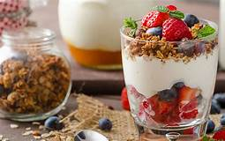
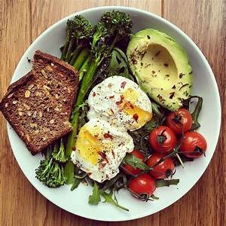
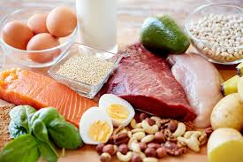
Kuidas toit annab kehale kütust?
Valgud: ehitusmaterjal, hoiab ja kasvatab lihaseid
Süsivesikud: annab keharakkudele energiat.
Rasv: aitab hoida töös ajunärvide funktsioone, kaitseb organeid, reguleerib hormoone, alandab kolestrooli, hoiab meid soojas.
Vitamiinid and mineraalid: tervendavad haavu, tugevdavad immuunsüsteemi, toodavad toidust energiat, parandavad.
Notes:
Facilitator note:
Use relevant photos of healthy foods from your state or region.
Ask:
Can anyone tell me what some examples of protein are? meat, fish, tofu, soy, eggs, nuts, dairy products, green vegetables, legumes.
Can anyone give me some examples of a carbohydrate? Fruit, vegetables, bread, rice, pasta
Everyone thinks fat is bad and should be totally avoided, but that is not the case. Our body needs fat to function, but it needs the right kind of fat, or healthy fat. What are some examples of healthy fats? Cheese, dairy products, fish, avocado, plant and cooking oils
Does anyone know where we get our vitamins and minerals from? Fruits and vegetables

Slide 8
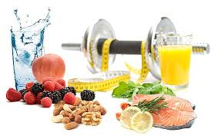
Miks on tervislik toitumine vajalik?
Hoiab keha ja vaimu terve
Annab kehale energiat, et hästi toimida ja liikuda
Aitab kehal kasvada ja ennast tervendada
Aitab kehal põletike ja haigustega võidelda
Parem sportlik saavutus ja taastumine
Rohkem energiat
Tugevamad lihased ja luud
Parem keskendumine
Notes:
Say: eating well helps you both on and off the field.

Slide 9
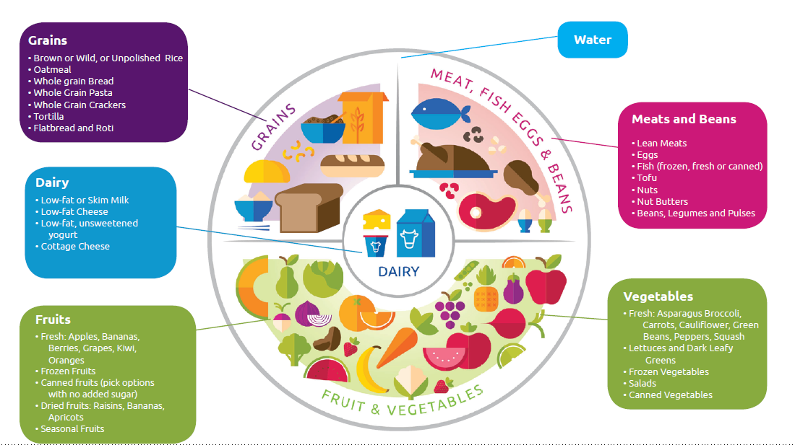
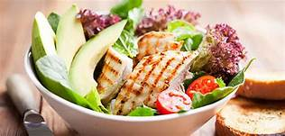
Milline on tervislik dieet?
Palju juurvilju & puuvilju
Täisteratooted rafineeritud toodete asemel
Valgud eelkõige taisest lihast, kalast, piimatoodetest, läätseest/ubadest, pähklitest ja tervislikest rasvadest
Mitte palju punast liha, rasvu, friteeritud või töödeldud toite
Vähendatud soola ja suhkru tarbimine, limonaadid ja alkohol välja
Notes:
Say:
A healthy diet Includes foods from all the different food groups.
If, for example, you just eat only fruits and vegetables, your muscles will be weak.
If you never eat vegetables, may get sick a lot.
If you eat too much sugar, if may give you a boost of energy initially but then you’ll crash and feel tired and sluggish soon after.
Facilitator note:
pull in a pictures of healthy foods or meals from your region, or an example of a healthy meal.

Slide 10
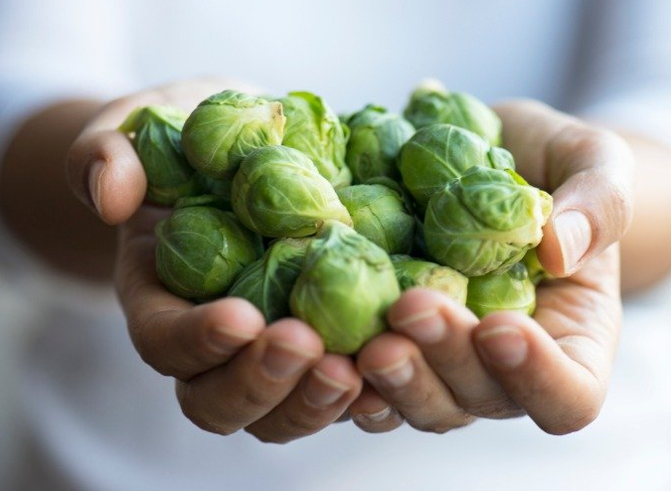
Kui palju puu-ja juurvilju peaksid sööma?
Soovitatud kogus on 5 portsjonit juurvilju ja puuvilju päevas
Kui suur on 1 portsjon?
1 handful = 1 serving
2 portsjonit puuvilju + 3 portsjonit juurvilju = 5 portsjonit päevas.
FRUIT = 2 handfuls
VEGETABLES = 3 handfuls
Notes:
Say:
The daily serving goal for fruits and vegetables is 5 servings a day, which breaks down to 2 servings a fruit and 3 servings of vegetables a day.
1 serving is equal to about 1 handful of fruits or vegetables. (put your hands together to show what a handful looks like).
You want to eat 2 servings, or handfuls, of fruit every day, and 3 servings, or handfuls of vegetables.
Facilitator note:
pull in a pictures of fruits and vegetables from your region.

Slide 11
Notes:
Facilitator’s note:
https://www.youtube.com/watch?v=DZN4r8p6KbU – use first part of clip (50 seconds)
Ask:
Did he do anything right?
What did he do wrong?

Slide 12
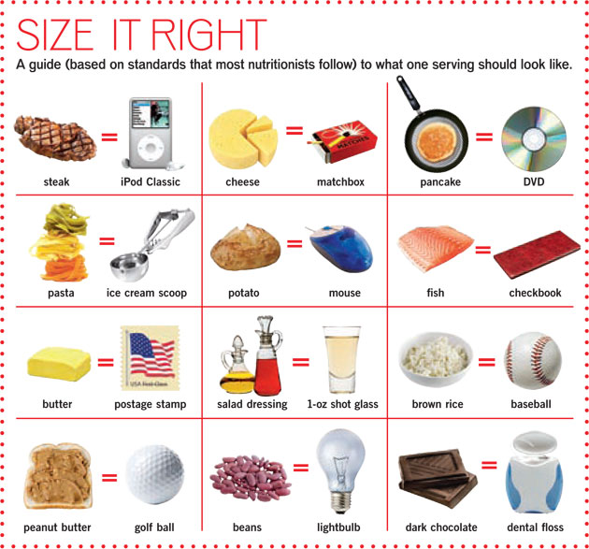
Portsjonite kontroll
Söö, mida su keha vajab
Kasuta väiksemaid taldrikuid ja
kausse
Ära näksi vahepeal
Hoia toit silma alt eemal
Söö aeglaselt
Katkesta söömine, kui kõht
on täis
Notes:
Facilitator note:
Review some of the proper portion sizes for different foods.
Consider using real or plastic food and the comparison object for a visual.
Ask: are there other things you try to do to control how much you eat?
Ask: does anyone keep their portions to these sizes?
(this question is not meant to shame attendees. Most people don’t know that they’re supposed to do this!)

Slide 13
Tegevus
Aruta koos paarilisega, milline oleks tervislik lõunasöök.
Notes:
Total time – 10 minutes
Group discussion – 5 minutes
Group reporting – 5 minutes (1 minute per group)
Facilitator notes:
Split the room into small groups (no more than 6)
Have each group select a spokesperson to report out.

Slide 14
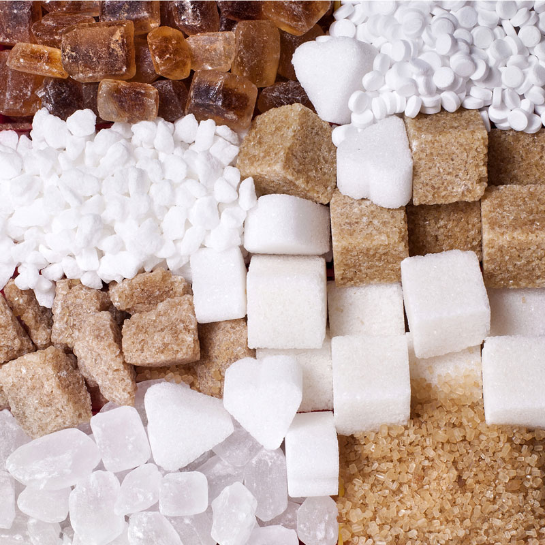
Vähenda lisatud suhkruid
Tühjad kalorid ei anna toitaineid.
Liiga palju suhkruid:
Tühjendavad su energiat
Võivad tekitada südame probleeme, diabeeti, ülekaalu ja terviseprobleeme
Nahk näeb vanem välja ja hambad lagunevad
Limit your added sugar intake:
Valmista ise kodus tervislikku toitu ja snäkke
Ära osta neid toite, mis on liiga suhkrused
Notes:
SAY:
The American Heart Association recommends the following daily added sugar limits:
Children and teens: less than 6 teaspoons a day;
Women: 6 tsp a day.
Men: 9 tsp a day.
Sugar provides no needed nutrients to our bodies and actually only does harm: it can make us gain weight, develop diabetes or lead to heart disease. Eating too much sugar also makes our skin look older and gives us cavities in our teeth.
Some ideas for swapping out sugar in your diet include (use culturally relevant examples):
Sweetening plain yogurt with fresh or frozen berries instead of buying flavored, sugar loaded yogurt.
Consuming whole fruits instead of sugar-sweetened fruit smoothies.
Replacing candy with a homemade trail mix of fruit, nuts and a few dark chocolate chips.
Using olive oil and vinegar in place of sweet salad dressings like honey mustard.
Choosing marinades, nut butters, ketchup and marinara sauce with zero added sugars.
Switching your morning cereal for a bowl of rolled oats topped with nut butter and fresh berries, or an omelet made with fresh greens.
Buying only fresh, whole ingredients at the grocery store.
ASK: what do you do to limit added sugar in your diet?

Slide 15
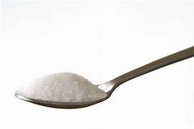
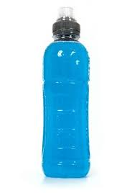
Mõtesta oma joogid ümber. Vali vesi.
AMOUNT OF SUGAR IN POPULAR DRINKS
13 teaspoons
MAXIMUM AMOUNT OF SUGAR
YOU SHOULD HAVE IN 1 DAY
1
9 teaspoons
10 teaspoons
6 teaspoons
7 teaspoons
5 teaspoons
0 teaspoons
MEN
WOMEN
1. Johnson, R.K., Lefevre, M., & Steffen, L.M. Dietary Sugars Intake and Cardiovascular Health:
A Scientific Statement From the American Heart Association (2009). Retrieved August 21, 2019 from https://www.ahajournals.org/doi/pdf/10.1161/circulationaha.109.192627
ENERGY DRINK
SODA
POP
ORANGE JUICE
SPORTS DRINK
WATER
Notes:
SAY:
Drinking just one sugar sweetened beverage per day often meets or exceeds the daily recommended added sugar limit.
Energy drink – 16 oz can; 13.5 tsp
Soda/pop – 12 oz can; 10 tsp
Orange juice – 10 oz serving; 7 tsp
Sports drink – 12 oz bottle; 5 tsp
Sugar-sweetened beverages provide few or no key nutrients.
Water has zero added sugar, so it is a great alternative to sugar-sweetened beverages.

Slide 16
Tegevus
Koosta tervislik menüü järgmisteks võistlusteks.
Notes:
Total time – 10 minutes
Group discussion – 5 minutes
Group reporting – 5 minutes (1 minute per group)
Facilitator notes:
Split the room into small groups (no more than 6)
Use a different spokesperson than the previous activity.
Discussion prompts:
We often have to work with what we’re given for our Games…but that doesn’t mean we always have to choose the unhealthiest options. Most restaurants have healthy options too, even McDonalds. Think about what those healthy lunch options could be.

Slide 17
Vedeliku tarbimine
Kas sa teadsid?
Notes:
Vesi moodustab enamuse meie kehast!

Slide 18
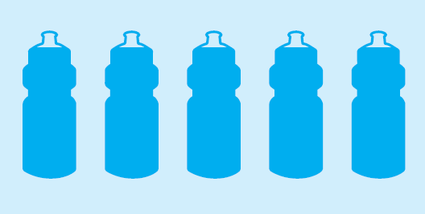
Vedeliku tarbimine
Vesi on parim valik
Joo vett kogu päeva jooksul
Eriline tähelepanu vedelikule, kui oled teinud trenni
Notes:
Ask: Who can tell me why water is good for you?
Water is good for your skin
It helps flush your body of toxins
It’s essential for athletic performance
It’s good for your muscles
It is important to stay hydrated with water, especially when we are playing sports because your body is sweating.
If you replace water for soda, it can help you lose weight
Say: Goal with Fit 5 is 5 water bottles of water per day

Slide 19
Vedeliku tarbimine
Notes:
Say: it’s needed for every function in our body!

Slide 20
Veetustumise märgid

Slide 21
Vedeliku tarbimine
Notes:
Say: the color of your urine will tell you if you are dehydrated or need to drink more water. The lighter your urine, the more hydrated you are. The darker it is, the more dehydrated you are. If you drink a steady amount of water throughout the day, your urine should stay in the 1 to 3 range.

Slide 22
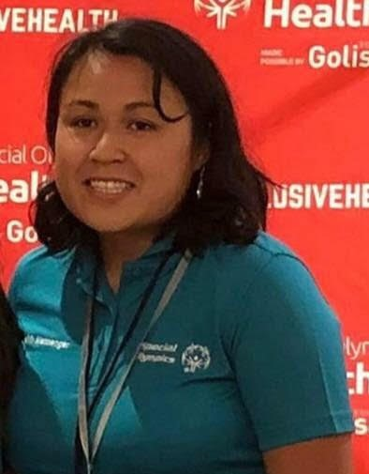
Nõuanded tervisesaadikult Lynnalt
Pool taldrikust peaks olema juurvilju või puuvilju.
Värske on alati parim. Külmutatud on järgmine valik. Kui sööd konserve, jälgi alati soolasuse infot.
Krõpsud, friteeritud toidud, limonaad, maiustused – need sisaldavad palju soola, suhkrut ja ebatervislikke rasvu. Mõõdukus on hea! Maiustused säästame erilisteks juhtumiteks.
Loe silte. Esimene sõna näitab, millega põhiliselt on tegu.
Vesi on oluline! Kanna endaga kaasas korduvkasutatavat veepudelit.
“Võin teile rääkida, kui palju ma end paremini tunnen tänu tervislikule toitumisele! Võtsin kaalust alla. Suudan joosta kiiremini ja kauem ning see aitas mul võita 4 medalit Eriolümpia Maailmamängudel.”
Lynna Hodgson, Special Olympics Missouri sportlane & tervisesaadik

